Slide 1
Tutorial 9
Statistical Computation and Analysis
Spring 2025

Slide 2
Tutorial Outline
Model comparison
Widely applicable information criteria
Cross validation
Model averaging

Slide 3
Model Comparison
How can we compare two or more models for the same data?
We have used posterior predictive checks to assess how well a model explains the data used to fit a model.
We have looked at Bayesian p values.
Now we’ll learn additional methods for comparing between models.

Slide 4
Model Comparison
We aim for:
High goodness of fit
Model fits the data
Lower complexity
Fewer parameters (more parameters can lead to overfitting)
High generalizability
Model predicts future data well

Slide 5
Model Comparison
Within-sample accuracy :
The accuracy is measured with the same data used to fit the model.
Out-of-sample accuracy :
The accuracy measured with data not used to fit the model.
The within-sample accuracy will be higher and lead us to believe our model is better than it is.
Leaving data out means less data to fit our model.

Slide 6
Model Comparison
To overcome this, we will use two methods:
Information criteria: Expressions that approximate out-of-sample accuracy as in-sample accuracy plus a term that penalizes model complexity.
Cross-validation: A method that involves dividing the available data into separate subsets that are alternatively used to fit and evaluate the models

Slide 7

Widely Applicable Information Criteria
A measure of how well the model fits the data
A measure of the effective number of parameters
We will choose the model with the lower WAIC.
The second term corrects for how much the likelihood would change if we had new data.
If two models fit the data equally well, we will choose the simpler one.
Notes:
The second - An estimate of how much worse the likelihood would be if we were looking at new data.
Correcting for how much the likelihood would change if I had new data.

Slide 8
Cross Validation
Divide our data into k parts.
Use k-1 parts to fit the model and test it on the left-out portion.
We get k models and k accuracy values.
The accuracy of the model is the average of the k accuracy values.
Fit the model on all the data one final time.
This is the final model for future use.

Slide 9
Cross Validation
When K equals the number of data points, we get what is known as leave-one-out cross validation (LOOCV), meaning we fit the model to all but one data point each time.
Practically, this is computationally expensive, and we are going to estimate it.

Slide 10
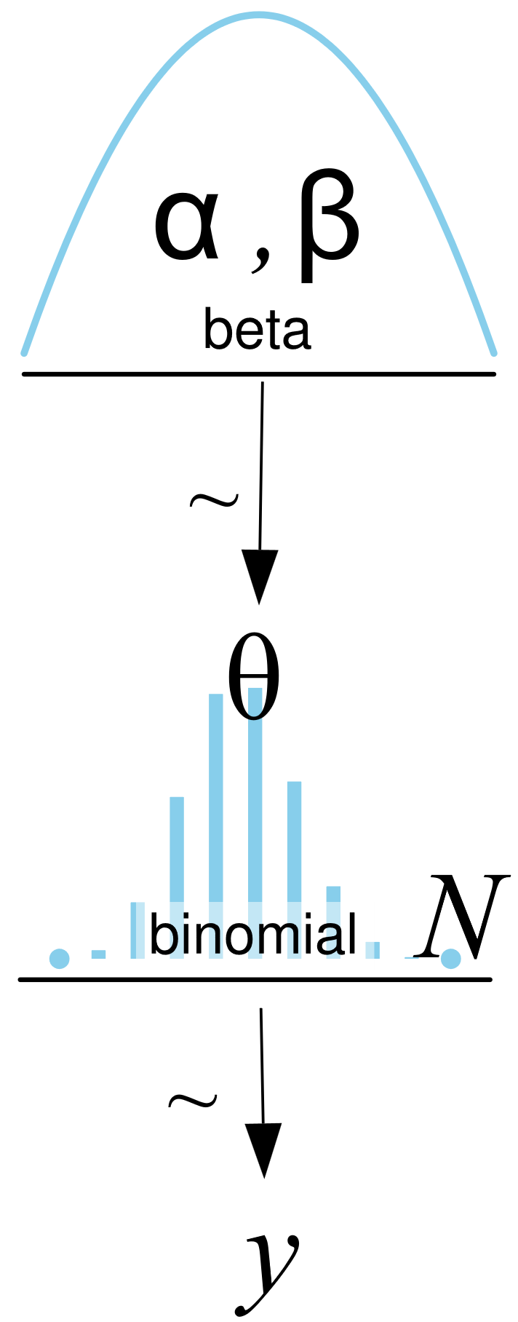
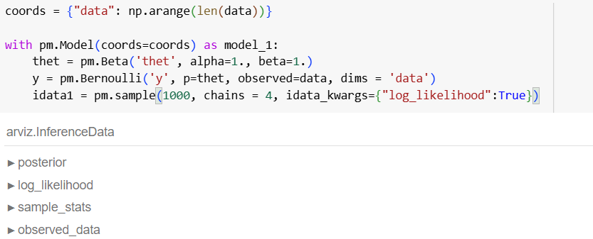
Null and Alternative Model
Null model: coin is fair.
Alternative model: coin is biased.
Graphical model
PyMC (a PPL)

Slide 11
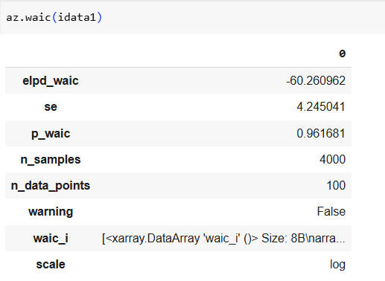
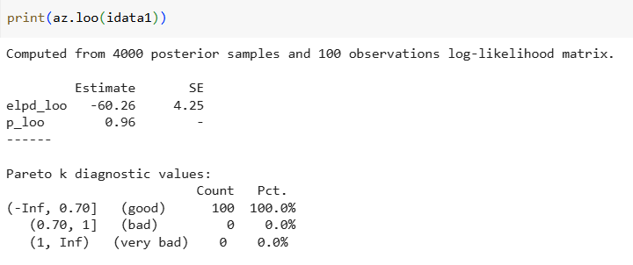
Null and Alternative Model
First, let’s look at the WAIC and LOO of our model:
Now let’s compare the values to those of the null
model.
Effective number of parameters
How reliable is our estimate?
Values above 0.7 indicate that we may have very influential datapoints – bad.
We can see that 100% of our datapoints are good.

Slide 12

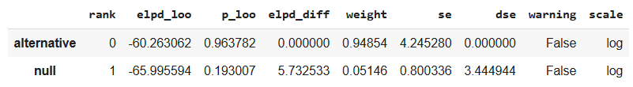
Null and Alternative Model
From best to worst
Higher = better
If the difference between the elpd values is bigger
than the standard error
Then we say that there is a meaningful difference between the two models

Slide 13
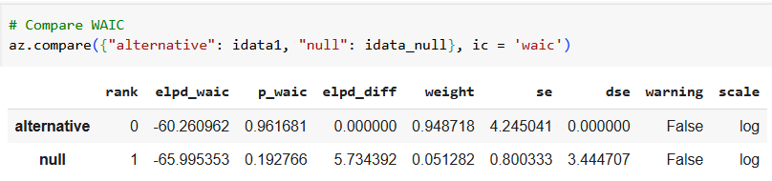
Null and Alternative Model
That was the LOO values, now we can do the same with the widely accepted information criteria.
The WAIC and LOO values are generally almost exactly the same.
At this point, it is generally more accepted to use the LOO.

Slide 14
Null and Alternative Model
We created the null model by using a very narrow posterior defined by the ROPE.
We defined the ROPE as [0.45, 0.55].
Another option for comparison is to check if the HDI and ROPE overlap.
Based on our model comparison using LOO and WAIC, we concluded that there is a meaningful difference between the null and alternative models.

Slide 15
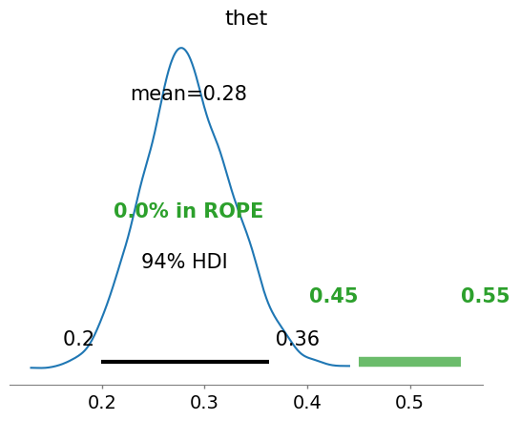
Null and Alternative Model
We arrive at the same conclusion looking at the HDI and ROPE
There is no overlap between them
We reject the null model of a fair coin

Slide 16
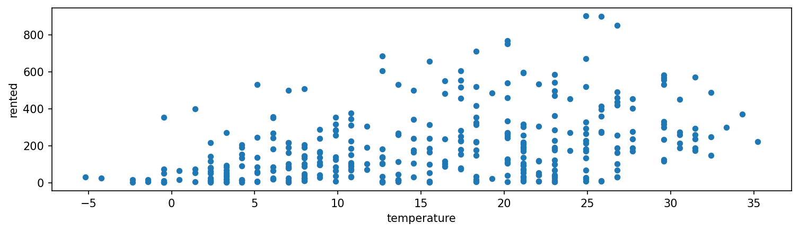
Bikes Example
In the lecture, you looked at bike rentals as a function of temperature using several models:

Slide 17
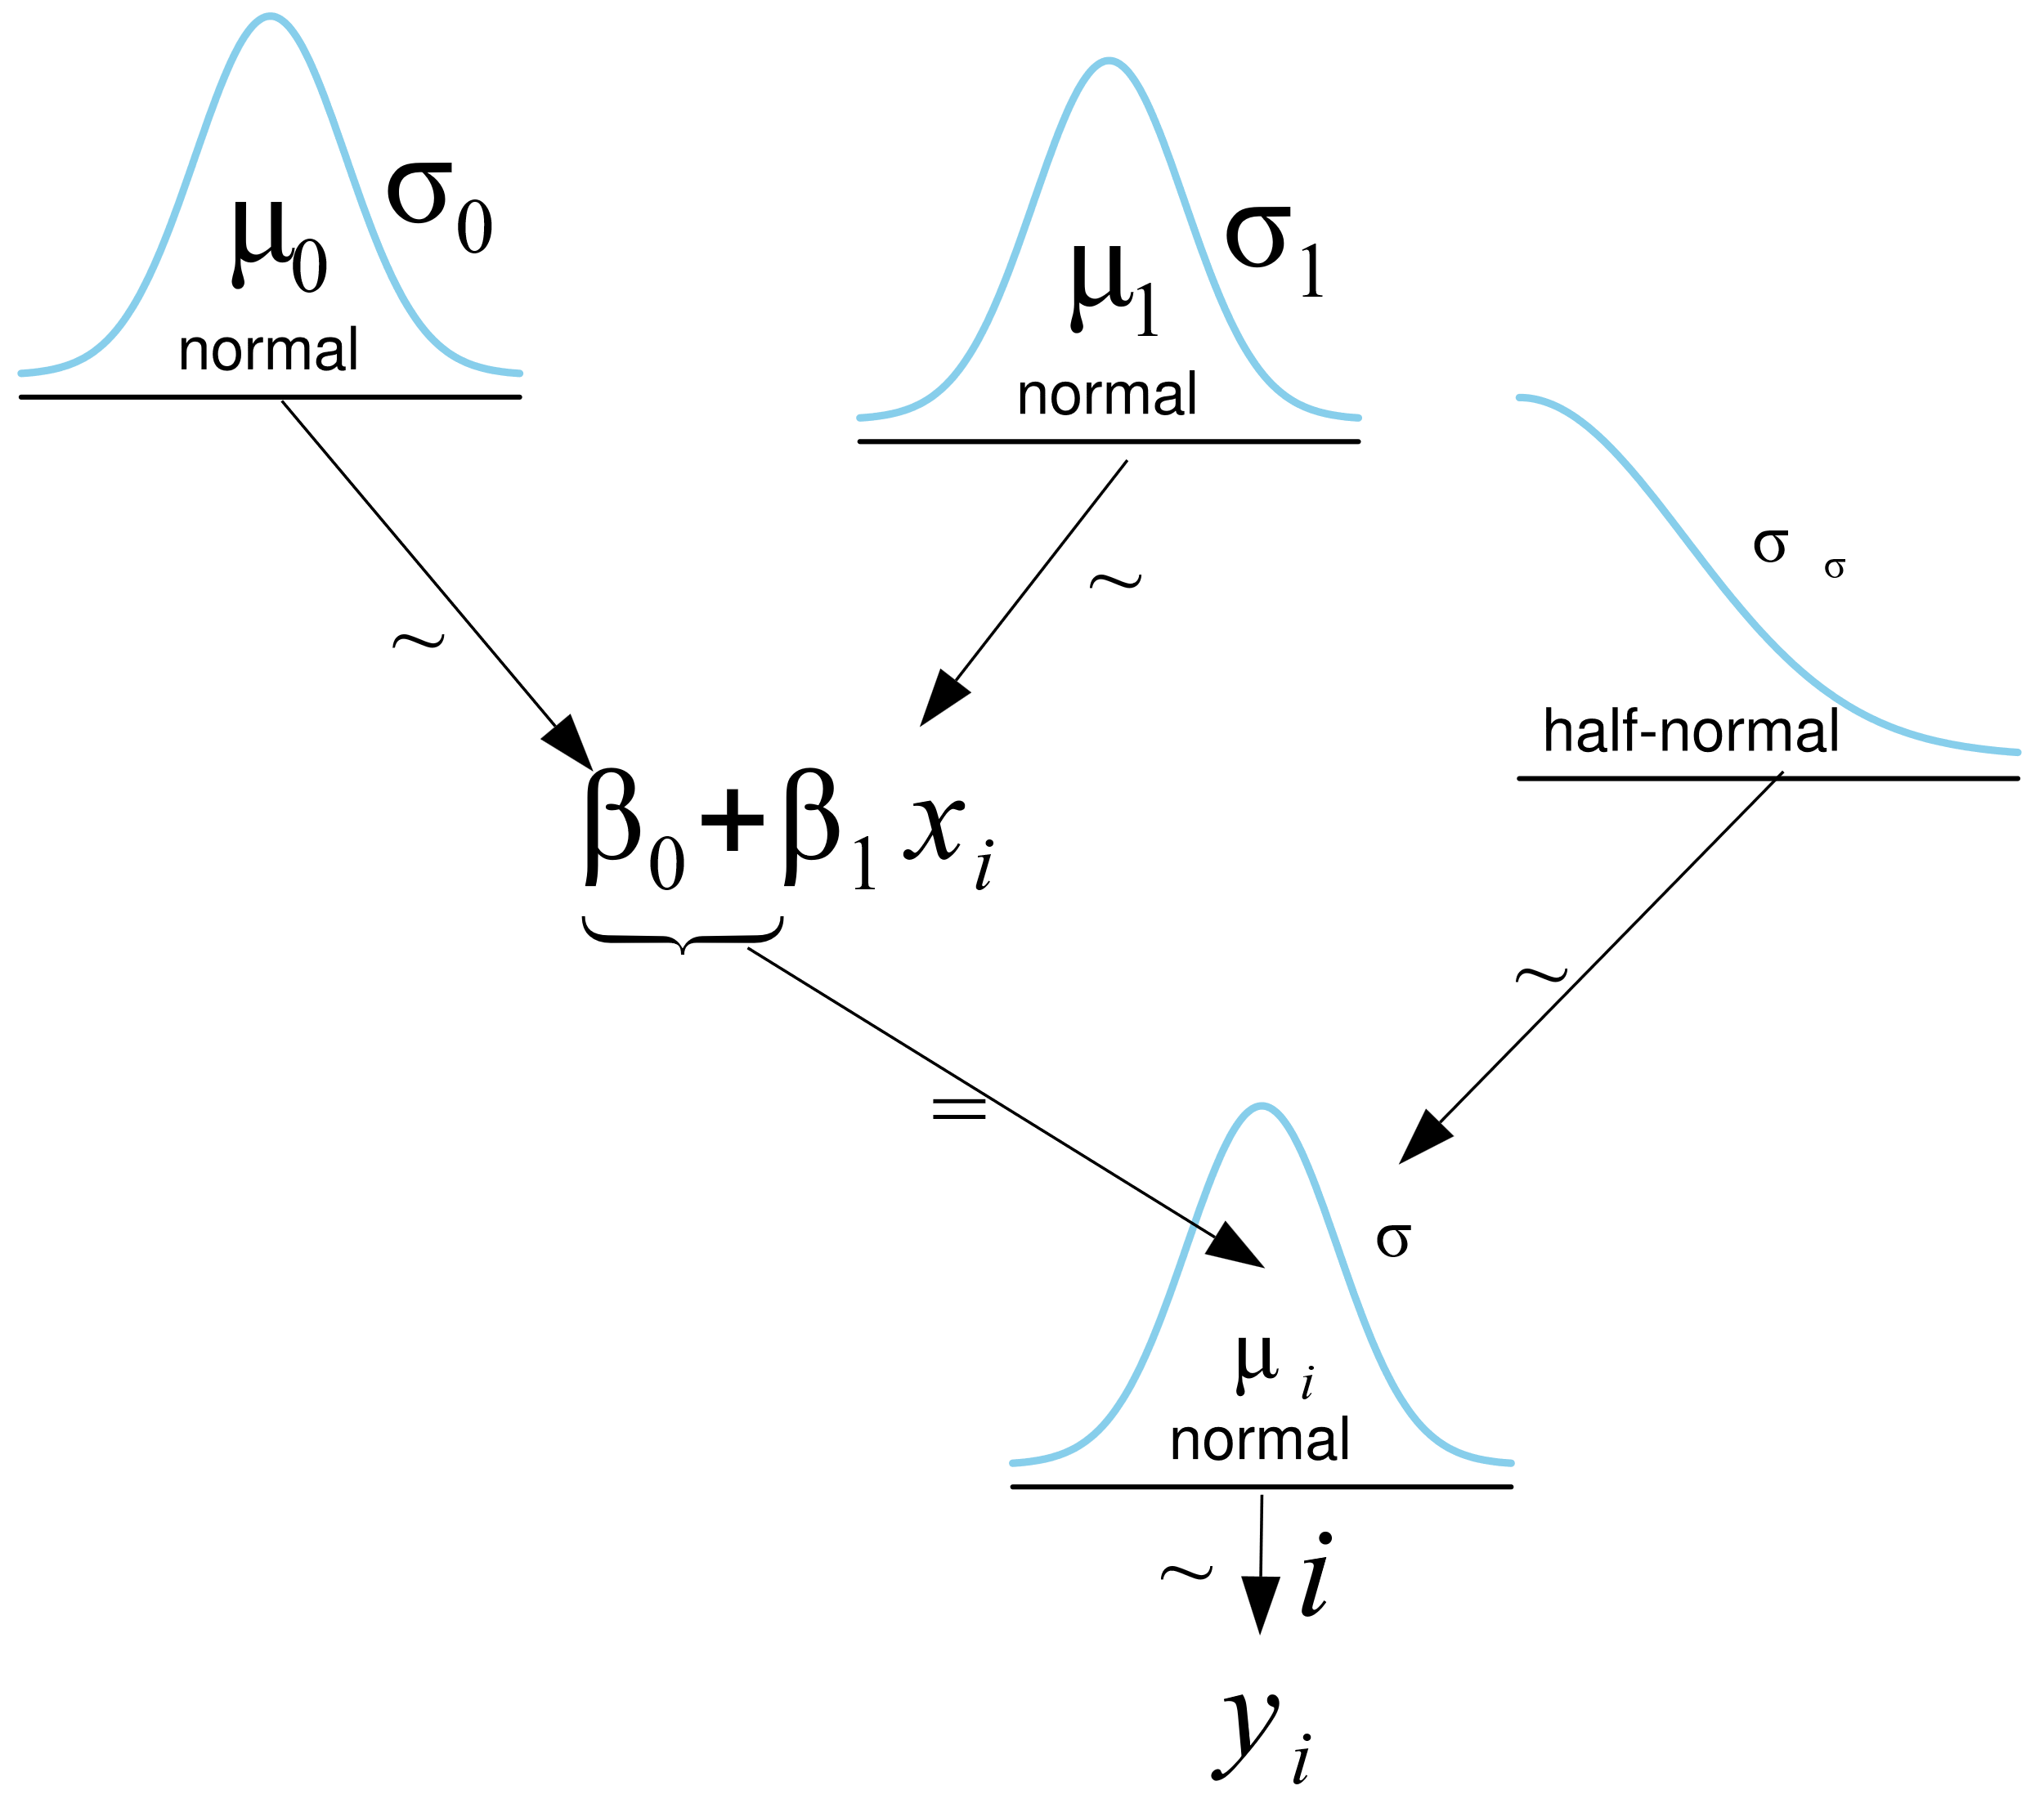
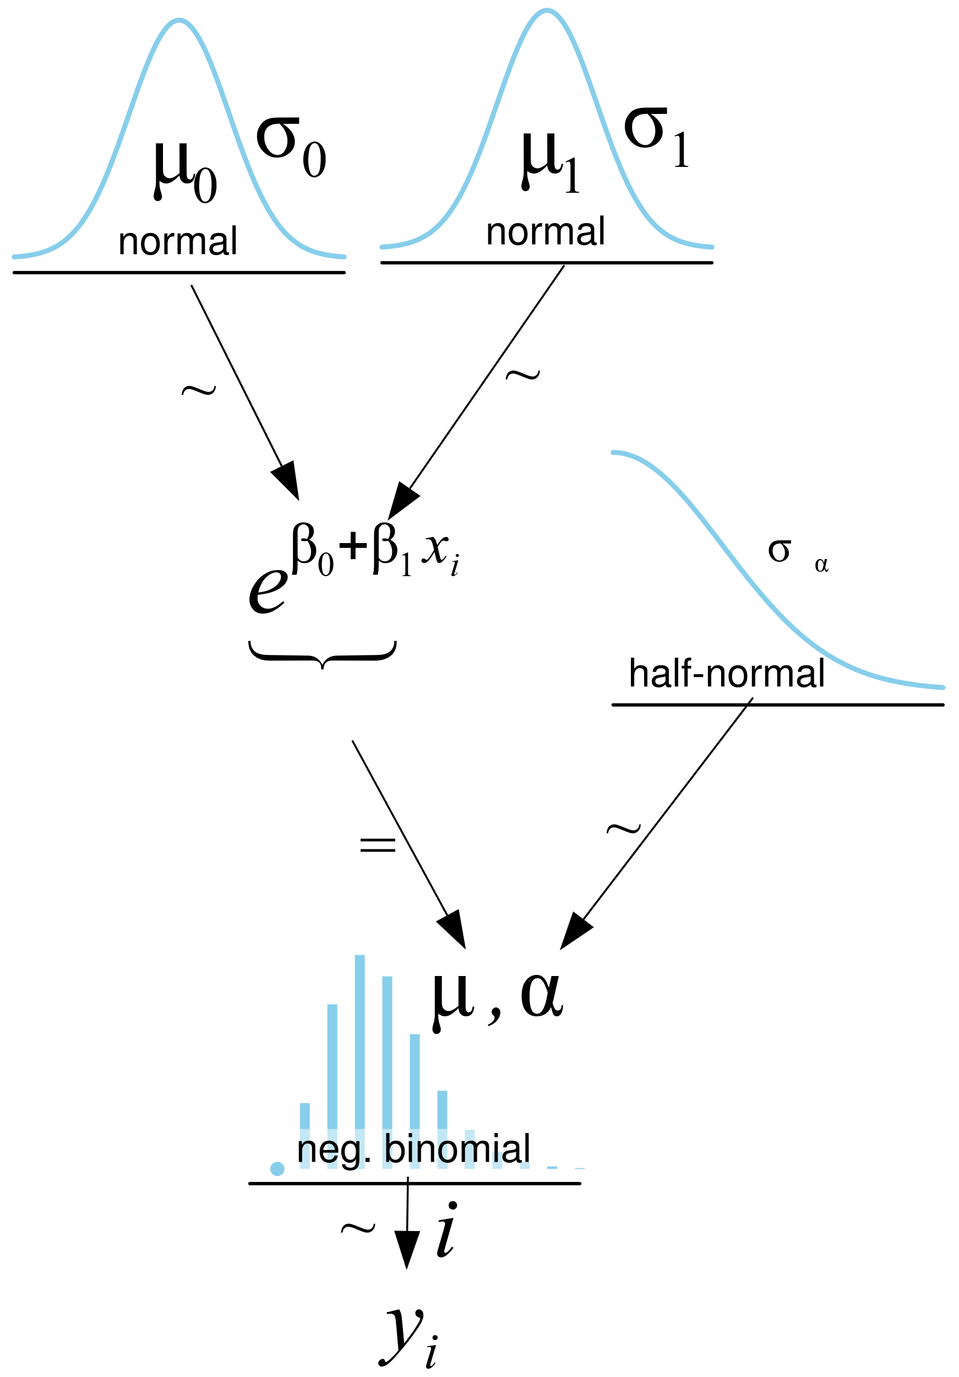
Bikes Example
In the lecture, you looked at bike rentals as a function of temperature using two models:
Linear Model
Negative Binomial Model

Slide 18
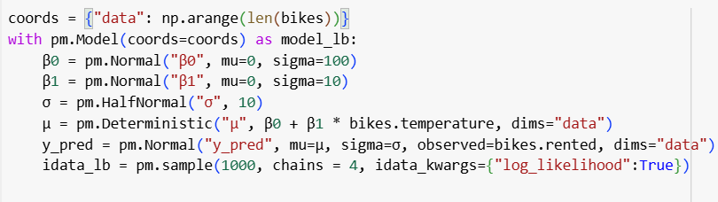
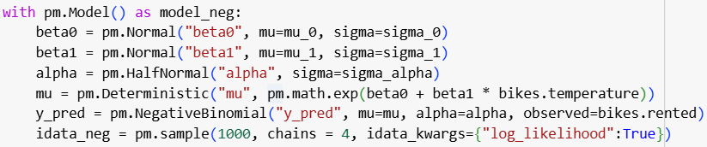
Bikes Example
In the lecture, you looked at bike rentals as a function of temperature using two models:
Linear Model
Negative Binomial Model

Slide 19
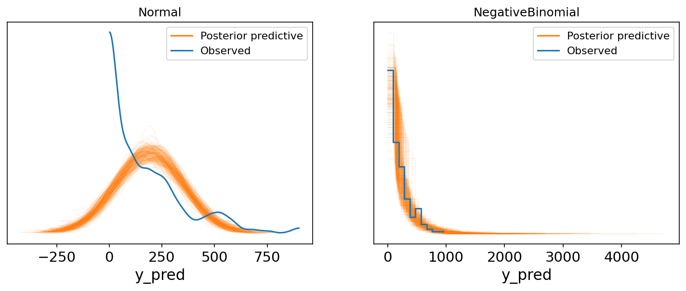
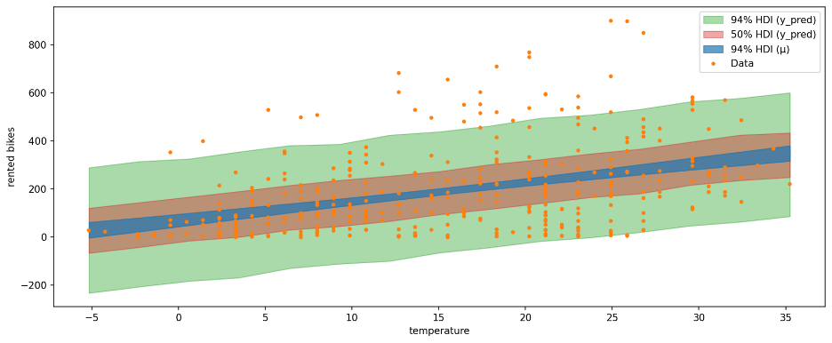
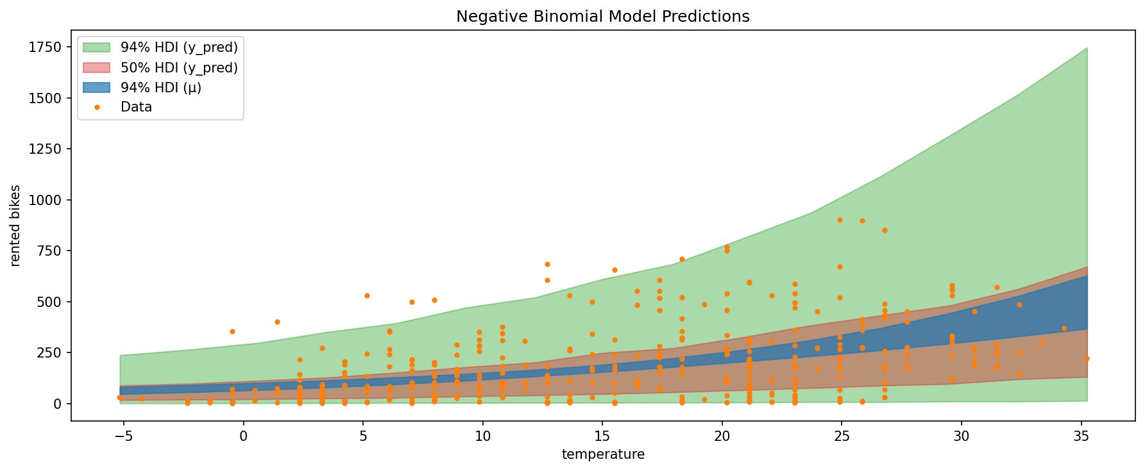
Bikes Example
In the lecture you compared the two using posterior predictive checks and saw that the negative binomial model was better:

Slide 20
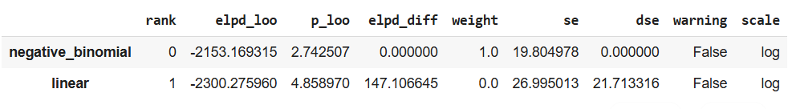
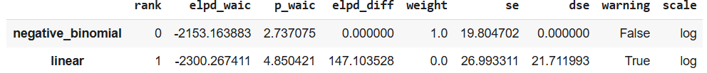
Bikes Example
Let’s add the WAIC and LOO to the comparison:

Slide 21
Bikes Example
We also learned about multiple regression.
Another use for model comparison can be to test the value of adding additional independent variables.
Adds information to the model.
Adds complexity.
We can add another independent variable of the humidity of the day.

Slide 22
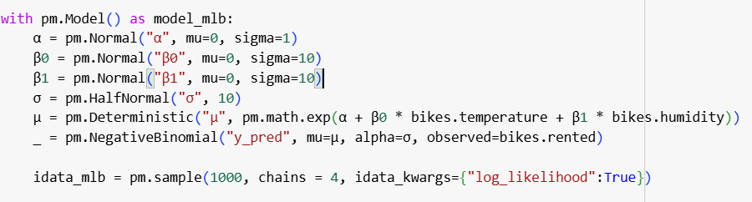
Bikes Example
Create and sample:

Slide 23
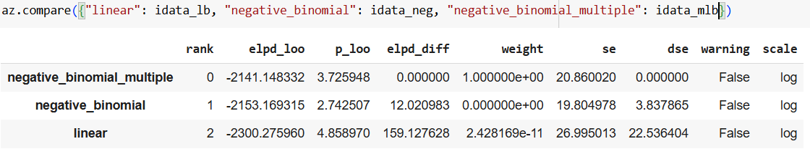
Bikes Example
Now let’s compare all three:
We can see that the difference between the LOO values for the two negative binomial models is larger than the standard error.
We can conclude from this that it is worth adding the humidity despite it leading to a more complex model.

Slide 24
Model Averaging
Instead of choosing one model, we can also average the different models.
We can compute a weighted average of the different models.
The weights are computed in the compare function.
They are the relative weight of each model and, in large, represent the probability of each model given the data.

Slide 25
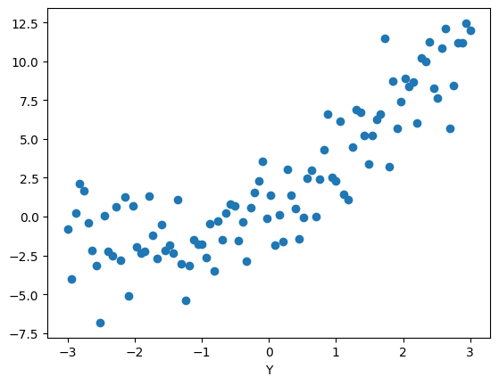
Model Averaging
Let’s create random data with two models that give not zero weights.
We’ll use a linear model
Simpler but fits data less well
And a quadratic model
Fits better but more complex

Slide 26
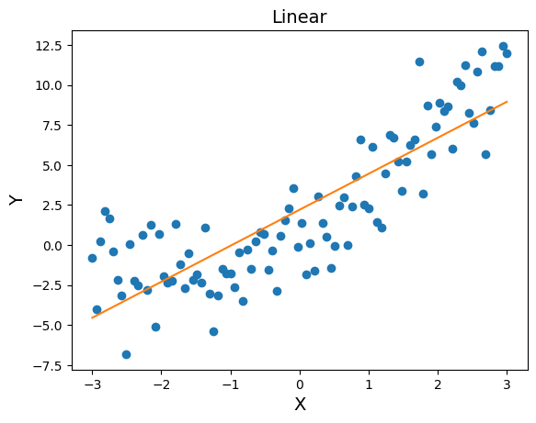
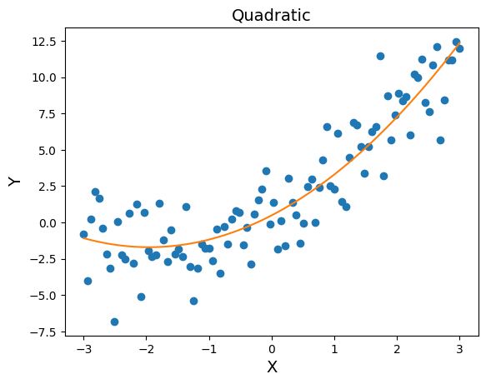
Model Averaging
The means of the two models:

Slide 27
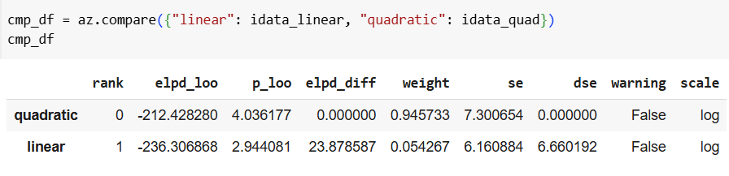
Model Averaging
Comparing between them yields:
We will use these weights to compute the weighted average model.

Slide 28
Model Averaging
Comparing between them yields:
We will use these weights to compute the weighted average model.

Slide 29
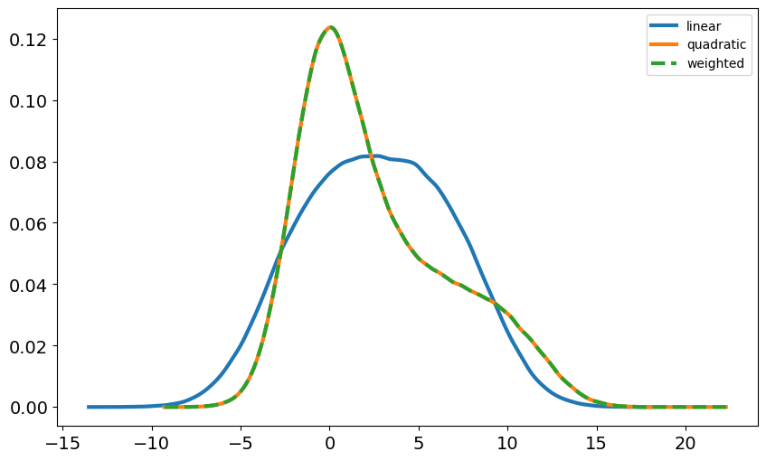
Model Averaging
Plotting:

Slide 30
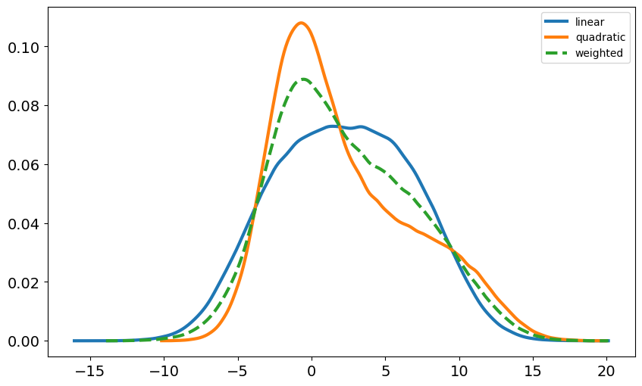
Model Averaging
We can also define the weights however we like.
Example: half to each of the two models.

